Slide 1
Lab Safety
Part 2

Slide 2
What is the number one concern in a fitness center?
S
a
f
e
t
y

Slide 3
Treadmill Video

Slide 4
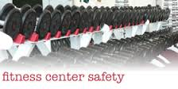
What is included in fitness safety?
Proper Equipment Use
Risk Management
Illness Prevention
Injury Prevention
Proper Exercise Form and Technique
Spotting

Slide 5
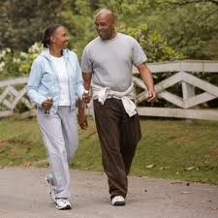
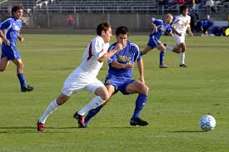
Explain the difference between weight bearing and non-weight bearing exercise.
Weight bearing exercise is any activity you do while on your feet and legs that works your muscles and bones against gravity. Examples include, walking, running, soccer etc.

Slide 6
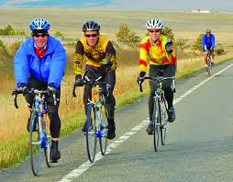
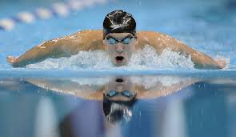
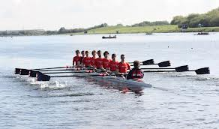
Explain the difference between weight bearing and non-weight bearing exercise
Non-weight bearing activities are typically seated and do not put as much stress on the joints. Examples include cycling, swimming and rowing.

