Slide 1
Illness Prevention

Slide 2
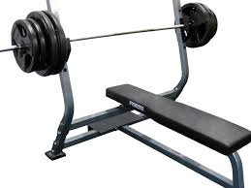
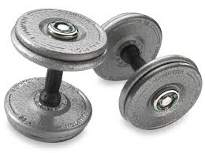
Dumbbell and Free Weight Areas
Weights are among the most handled items in a fitness center
Carry risk for common cold, influenza and gastrointestinal infections

Slide 3
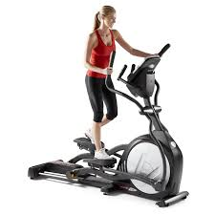
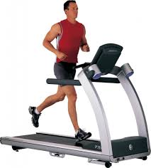
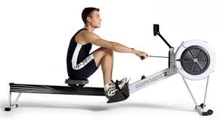
Cardiovascular Area
Handles and buttons are most common areas to hold germs
Don’t use your hands to wipe away sweat, use a towel instead

Slide 4
Shower and Locker-room Areas
Most common infection at the gym is Athlete’s foot which thrives on damp floors
Don’t go barefoot anywhere in the gym.
In locker rooms wear shower shoes and dry your feet well before putting on clean socks and dry shoes

Slide 5
Pictures of Athlete’s Foot

Slide 6
Pictures of Athlete’s Foot

Slide 7
Pictures of Athlete’s Foot

Slide 8
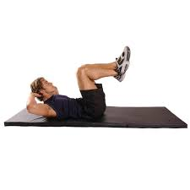
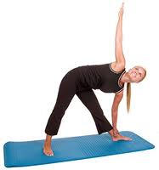
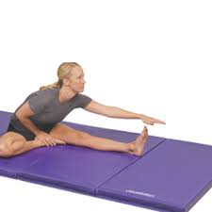
Mats
Germs that cause ringworm, respiratory and gastrointestinal infections like mats.
Use a disinfectant wipe before and after using the mat to prevent infection

Slide 9
Water Fountains
Wet areas are the most contaminated areas
Don’t let your lips or bottle touch the water fountain’s spout
Don’t spit into the water fountain

Slide 10
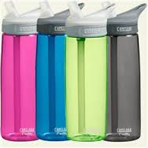
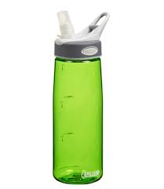
Water Fountains
Don’t wipe your mouth after sipping
If you use a water bottle clean it everyday

Slide 11
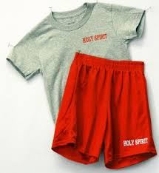
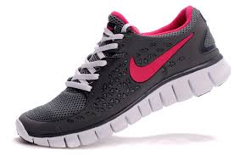
Your Gym Bag
Germs are carried on clothing
Put clothes and shoes in a plastic bag inside your gym bag

Slide 12
Your Gym Bag
Wash clothes and towels on a temperature wash cycle, don’t re-wear dirty clothes
Wash your bag regularly or at least spray it with a sanitizing spray

Slide 13
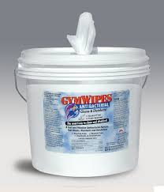
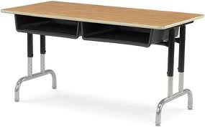
Daily Cleaning Procedures
After using any piece of equipment wipe it down with a gym wipe
At the end of lab clean all surfaces (desks, counters, equipment) with a gym wipe

Slide 14
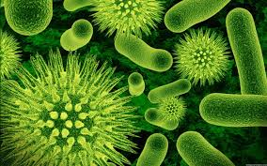
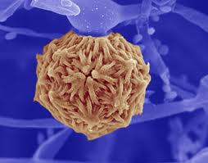
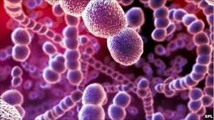
What infections are you risk for?
Anyone that trains in a fitness facility, physical therapy clinic are at risk for fungal, viral and bacterial skin infections.

Slide 15
What infections are you risk for?
Sweat, abrasion and direct or indirect contact with secretions of others make everyone’s skin vulnerable to a host of problems.
Individuals who are infected should not train until after their doctor medically clears them for exercise.

Slide 16
What germs are found in training facilities?
Klebsiella
Staphylococcus Aureus
Candida
Influenza
E. Colli
Human Papillomavirus
Streptococcal Bacteria

