Slide 1
Injury Prevention

Slide 2
A Personal Trainers Responsibility
One of the personal trainer’s most important responsibilities to clients is to instruct and manage their exercise technique to ensure maximum benefit from resistance training in the safest possible environment.

Slide 3
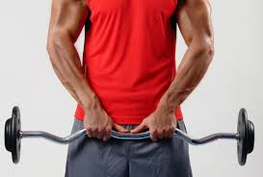
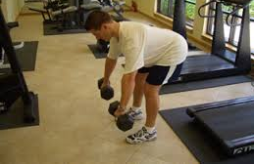
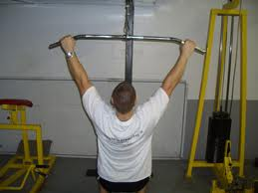
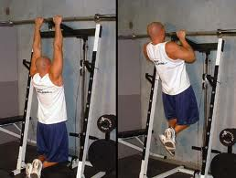
Various Handgrips that can be used when lifting
Pronated
Palms down and knuckles up, also called the overhand grip

Slide 4
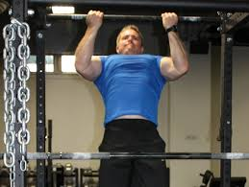
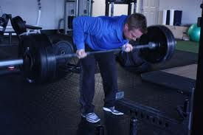
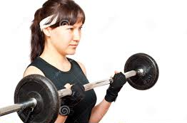
Various Handgrips that can be used when lifting
Supinated
Palms up and knuckles down, also called the underhand grip

Slide 5
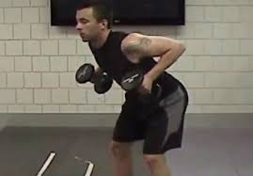
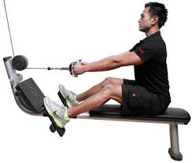
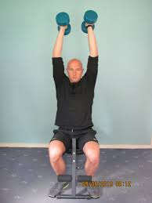
Various Handgrips that can be used when lifting
Neutral
Palms face in and the knuckles point out to the side, like a handshake

Slide 6
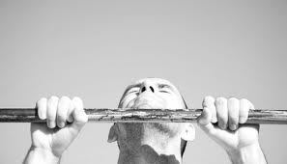
Various Handgrips that can be used when lifting
Closed
The thumb is wrapped around the barbell so that the barbell is fully held by the hand

Slide 7
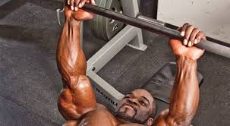
Various Handgrips that can be used when lifting
Open
The thumb does not wrap around the barbell, but is instead placed next to the index finger
Safety concern- bar will roll off of hand

Slide 8
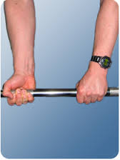
Various Handgrips that can be used when lifting
Alternated
Used when spotting a barbell, one hand is pronated and one hand is supinated

Slide 9
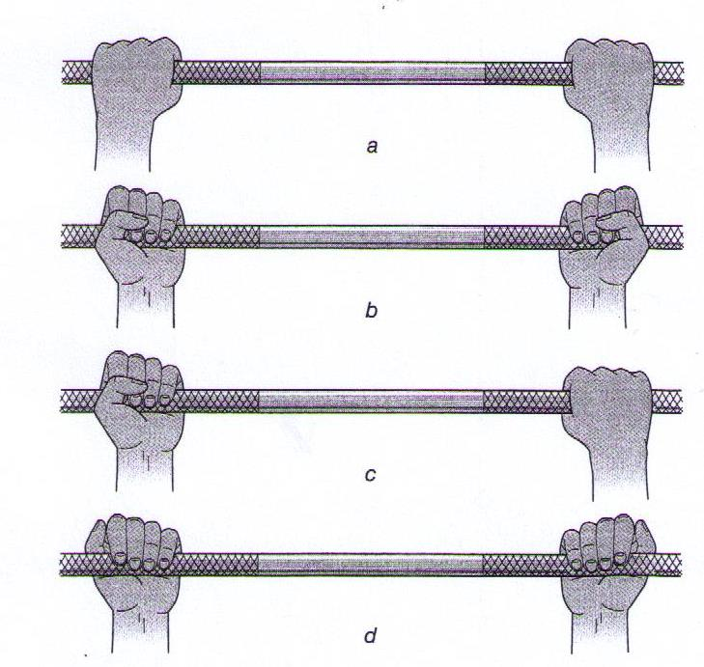
Label the following grips and indicate is the grip is open or closed
A.
B.
C.
D.
Pronated, Closed
Supinated, Closed
Alternated, Closed
Supinated, Open

Slide 10
How to Demonstrate Exercises to Clients
When demonstrating a new exercise to a client the personal trainer should begin with how to establish a starting position.
From this position, the client is able to maintain correct body alignment throughout the exercise, thereby placing stress only on the targeted muscles.

Slide 11
Explain Starting Position for the following exercises:
Standing
Client’s feet at or between hip width and shoulder width apart with feet flat on the floor

Slide 12
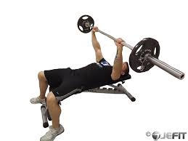
Explain Starting Position for the following exercises:
Supine exercises (lying on back):
Both feet are on the floor and the back of the head, upper back and rear shoulders, lower back and buttocks are supported by bench.

Slide 13
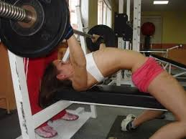
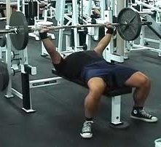
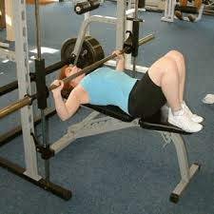
Explain Starting Position for the following exercises:
This:
Not That:

Slide 14
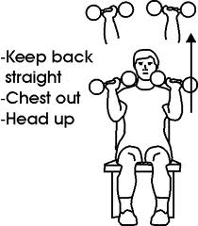
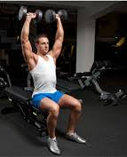
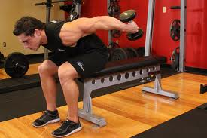
Explain Starting Position for the following exercises:
Seated exercises:
Both feet in contact with the ground, sitting tall with abdominals engaged and shoulders relaxed

Slide 15
Why is it Important to Remind Client’s to Breathe?
Many people tend to hold their breath when they work out, when exercising muscles require more oxygen.
Failing to breathe can lead to dizziness and could even lead to the client passing out.

Slide 16
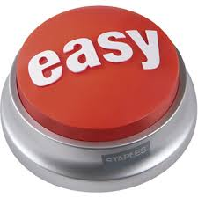
When Should a Personal Trainer Tell a Client to Breathe?
Breathe out during the hardest part of the exercise and breathe in during the easiest part of the exercise

Slide 17
What is the Valsalva Maneuver?
Expiration of air against a closed glottis which causes increased intra-thoracic pressure and increased systolic blood pressure.
It is a dangerous practice because it can lead to stroke.

Slide 18
What are the Four Free-Weight Exercises that Require a Spotter?
Overhead (standing shoulder press)
Over the face (Bench press, lying triceps extension)
With a bar on the upper back and shoulders (back squat)
With a bar positioned on the front of the shoulders or clavicles (front squat)

Slide 19
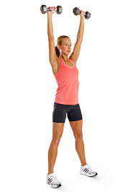
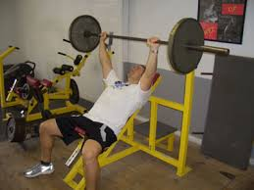
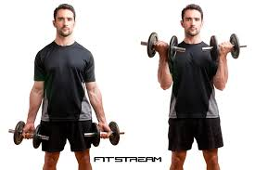
Why is the Greater Potential for Serious Injury with Overhead or Over the Face Exercises?
Because of the location of the barbell or dumbbell in relation to the client’s head or face.
More Potential for injury
Less Potential for injury

Slide 20
Explain how a Personal Trainer Should Spot Overhead and Over the Face Exercises:
Using a Barbell:
Grasp the bar between the client’s hands with an alternated grip.
Take position as close to the client as possible.
Stand with feet in a staggered stance.
Using a Dumbbell:
Spot the client’s wrists very near to the dumbbell.
Special Consideration:
When spotting an overhead exercise, a personal trainer may need to use a platform to properly spot the client

Slide 21
Explain how a Personal Trainer Should Spot When a Bar is Placed on Upper Back and Shoulders:
Using a Barbell:
Stand very close to the client and be prepared to hug and lift the client if he or she is not able to complete the set.
Special Consideration:
If the load is beyond the personal trainer’s ability to handle effectively an additional spotter must be used.

Slide 22
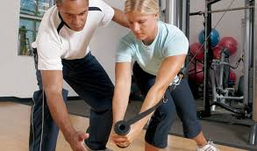
The Importance of Communication
Communication when spotting is the responsibility of both the client and the personal trainer. A client should be instructed to tell the personal trainer when he or she is ready to move the equipment into the starting position.

Slide 23
What Should Personal Trainers Ask Clients When Preparing to Spot?
Does the client need help getting started?
How many repetitions does the client want to perform?
How many repetitions does the client think he or she can perform?

