Slide 1
All About the Treadmills
Safety Guidelines

Slide 2
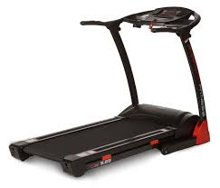
What is a treadmill?
Device used for walking or running while staying in the same place

Slide 3
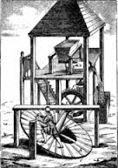
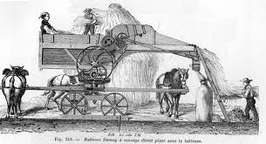
Treadmill Timeline: 2000 BC
Treadmill originated as a power source for farmers, the primary use was to lift buckets of water and grinding grain

Slide 4
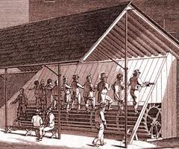
Treadmill Timeline: 1818 AD
Sir William Cubit promotes the use of treadmills as punishment for prisoners. Prisoners were required to stand side by side on a wheel and were required to work 6 hour more hours per day.

Slide 5
Treadmill Timeline: 1913
First US Patent of a treadmill training machine

Slide 6
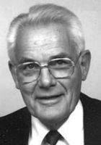
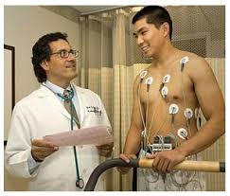
Treadmill Timeline: 1952
Dr. Robert Bruce began using exercise treadmills to diagnose heart and lung disease

Slide 7
Treadmill Timeline: 1968
Dr. Kenneth Cooper published research on the benefits of aerobic exercise

Slide 8
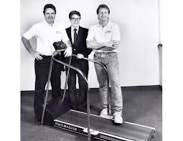
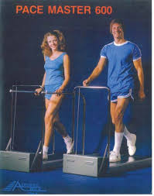
Treadmill Timeline: 1969
William Staub developed the first treadmill for home use called the Pace Master 600

Slide 9
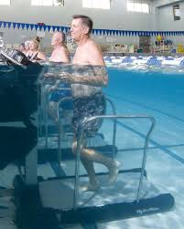
Treadmill Timeline: 1982
Hudson Aquatic created an underwater treadmill which allows people with arthritis the benefits of walking, with less pain on their joints due to the buoyancy created by the water

Slide 10
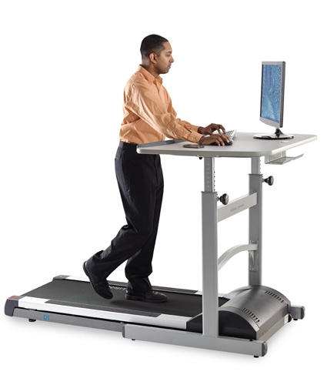
Treadmill Timeline: 1996
Dr. Seth Roberts designed a treadmill desk, allowing people that normally sit at a work station to walk at very slow speeds while completing their tasks. Some users can walk up to 6 miles per day.

Slide 11
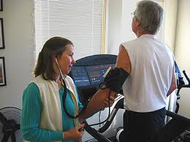
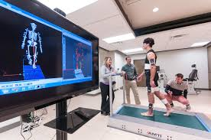
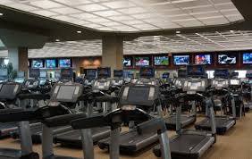
Where are treadmill used today?
Cardiac Rehabilitation Facilities
Biomechanic Institutes
Gyms

Slide 12
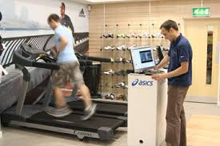
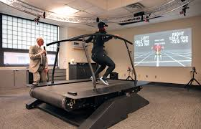
Where are treadmill used today?
Running Stores
Olympic Training Centers
University Athletics

Slide 13
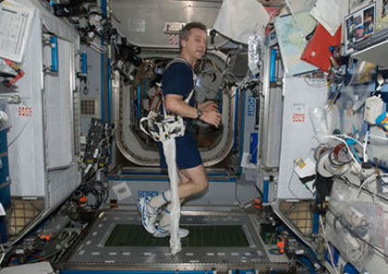
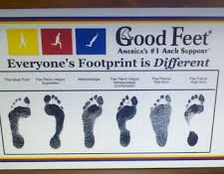
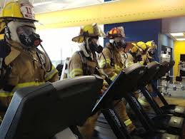
Where are treadmill used today?
NASA
Orthopedic Shoe Stores
Police & Fire Academies

Slide 14
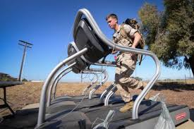
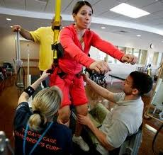
Where are treadmill used today?
Military Training Centers
Physical Therapy Clinics

Slide 15
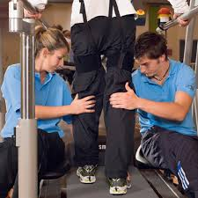
What is a manual locomotion therapy?
Used in rehabilitation settings, therapists will sit next to a treadmill and move the legs of a stroke patient in order to stimulate walking movements to help the patient learn how to walk again.

Slide 16
What are the advantages of treadmills?
Can be used any day or time regardless of weather
Cushioned tread provides lower impact compared to running on outdoor surfaces
Incline setting can be set for constant uphill training
Ability to train at a consistent pace
User can watch TV, which prevents TV from being a sedentary activity
User progress including distance, calories burned and heart rate can be tracked

Slide 17
What are the disadvantages of treadmills?
Many users find treadmills monotonous and may lose interest
May cause runners to develop poor running habits, arms close to body short gait
Does not offer sport specific training – no sport actually uses treadmill running
Costs is much more significant than training outside

Slide 18
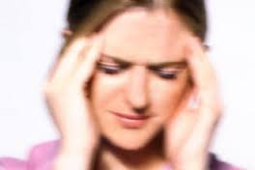
Treadmill Safety/Injury Concerns- Dizziness
Two reasons people can feel dizzy.
due to a lack of a cool down. A cool down returns heart rate and blood pressure to resting levels and helps prevent blood from pooling in the legs. A 5-10 minute cold down is recommended to prevent dizziness.
Due to the inner ear balance receptors being overstimulated while on the treadmill. Balance and dizziness should subside after 5 minutes.

Slide 19
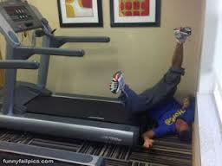
Treadmill Safety/Injury Concerns- Falls
Caused by not looking forward which can cause a person to lose balance and fall. Also caused by people jumping off and on treadmills while they are still running. Treadmills need to be placed at least 4 feet away from a wall in the event someone falls off the back.

Slide 20
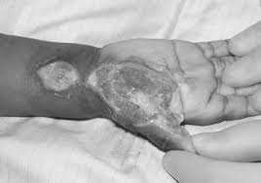
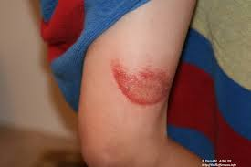
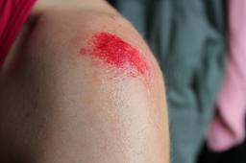
Treadmill Safety/Injury Concerns- Friction Burn
Occurs when someone falls and the treadmill continues to run rubbing the skin raw. May require skin grafts and could result in long-term disability

Slide 21
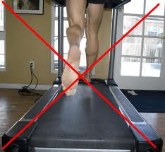
Treadmill Safety/Injury Concerns- Lower Body Injuries
Caused by not wearing proper shoes or not wearing shoes at all. Can cause blisters, heel spurs and ankle, knee and hip problems.

Slide 22
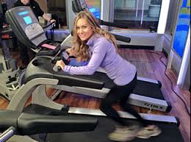
Treadmill Safety/Injury Concerns- Upper Body Injuries
Pain and discomfort that is felt in wrist, upper back, neck and lower back. Caused by relying too much on the handrails and not walking in an upright position.

Slide 23
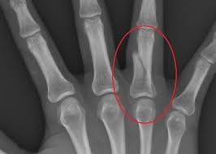
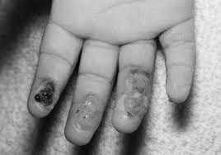
Treadmill Safety/Injury Concerns- Hand Injuries
Happens more with children in the home, kids will come up to a moving treadmill and try to place their hand under the moving belt. Can lead to friction burns and broken fingers.

Slide 24
Preventing Treadmill Injuries
Use the safety tether
Pause the treadmill if you need to step off
Straddle the belt when you start
Maintain an upright position
Keep your eyes forward
Use handrails sparingly
Wear appropriate shoes

Slide 25
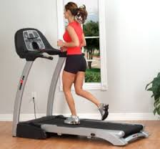
Proper Body Alignment
Keep the back straight and torso centered over the pelvis
Keep the chest lifted and shoulders drawn back
Keep abdominals engaged
Relax arms at the side

Slide 26
Safety Considerations
Never operate the treadmill if it has a damaged cord or plug, not working properly or if water has been spilled on it.
Keep the cord away from heated surfaces. Never operate the treadmill with the air openings blocked.
Keep the air openings free of lint, hair etc. Never drop or insert any object into any opening.
Changes in speed and incline do not occur immediately, the treadmill will adjust gradually.

Slide 27
Safety Considerations Cont.
Use caution while walking or running, distractions may cause you to lose balance which could lead to serious injury. NO CELL PHONES!
Do not use excessive pressure in the console control keys.
Safety tether must be worn at all times.
Mandatory 2 minute cool down on all programs.

Slide 28
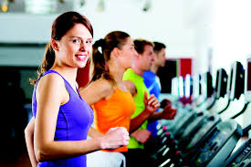
Programs
Manual
Hill
Fat Burn
Cardio
Strength
Interval

Slide 29
Getting Started
Turn the power switch on (located on the front of the treadmill below the motor cover). Safety key must be installed or the treadmill will not work without it.
When power is turned on all the lights on the display will light for a short time.
Treadmill will then enter idle mode, this is the starting point for operation.

Slide 30
Cleaning and Maintenance
Treadmill users will clean the equipment after every use with a gym wipe and remove any trash. Additionally, students will complete a deep cleaning of the treadmill weekly.

Slide 31
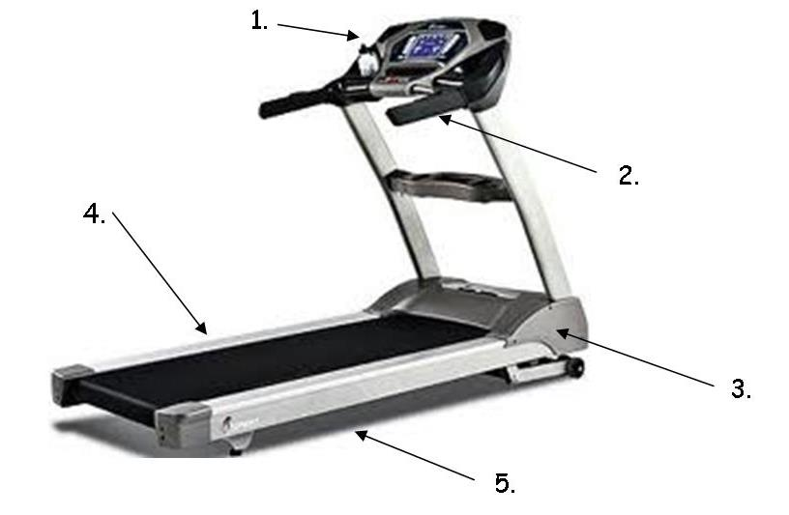
Cleaning the Treadmill: Every Use
Console
Handles and Heart Rate Monitors
Motor Covering
Belt Side Panels
** Remove Trash

Slide 32
Cleaning the Treadmill: Weekly
Console
Handles and Heart Rate Monitors
Motor Covering
Belt Side Panels
Mat under the treadmill
** Remove Trash

