Slide 1
All About the Ellipticals
Safety Guidelines

Slide 2
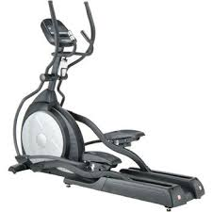
What is an elliptical?
A stationary exercise machine used to simulate stair climbing, walking or running without causing excessive pressure to the joints, which decreases the risk of impact form injuries.

Slide 3
When did Elliptical trainers first enter the market?

Slide 4
What are the benefits of using an elliptical machine?
Produce and intermediate range of leg motion between stationary bikes and treadmills
Rate at which calories are burned is similar to a treadmill
Large muscle groups are used

Slide 5
Elliptical Safety/Injury Concerns- Numbness in the Feet
Caused by putting too much weight on your toes. Placing the weight on your toes, or constantly using your toes to push off the elliptical with each stride will cause injury to the connective tissue on the bottom of your foot. Plant your feet flat on the pedals of the elliptical machine.

Slide 6
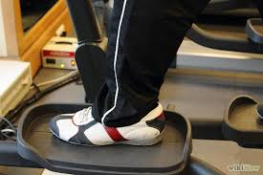
Elliptical Safety/Injury Concerns- Falls
Caused by not stepping onto an elliptical properly. Step up onto the foot pedal closet to the ground and then step onto the other foot pedal.

Slide 7
Elliptical Safety/Injury Concerns- Upper Body Injuries
Pain and discomfort that is felt in wrist, upper back, neck and lower back. Caused by relying too much on the handrails and not pedaling in an upright position.

Slide 8
What is proper body alignment when using an elliptical?
Keep your shoulders back, your head up and your abdominal muscles tight.
Look forward, not down at your feet.
Keep weight evenly distributed between the heels and the balls of the feet.
Don't lean on the handles — let your lower body support your weight.

Slide 9
Safety Considerations
Keep hands away from all moving parts
Never operate the treadmill if it has a damaged cord or plug, not working properly or if water has been spilled on it.
Keep the cord away from heated surfaces.
Never drop or insert any object into any opening.
To disconnect, turn all controls to the off position, then remove the plug from the outlet.

Slide 10
Safety Considerations Cont.
Use caution while using the elliptical, distractions may cause you to lose balance which could lead to serious injury. NO CELL PHONES!
Do not use excessive pressure in the console control keys.
Wear proper shoes. High heels, dress shoes, sandals or bare feet are not suitable for use on your elliptical. Quality athletic shoes are recommended to avoid leg fatigue.
Mandatory 2 minute cool down on all programs.

Slide 11
Programs
Manual
Hill
Fat Burn
Cardio
Strength
Interval

Slide 12
Getting Started
Turn the power switch on (located on the front of the elliptical below the motor cover).
Step up onto the foot pedal closet to the ground and then step onto the other foot pedal.
If you hear a squeak while on the elliptical clean the rails and wheels of the elliptical with a lint free cloth and rubbing alcohol.

Slide 13
Cleaning and Maintenance
Elliptical users will clean the equipment after every use with a gym wipe and remove any trash. Additionally, students will complete a deep cleaning of the treadmill weekly.

